Slide 1
OIL PRICE PREDICTION Group-6 Mentor: Aishawarya Ajay Mate
Date :22/08/2023

Slide 2
Business Problem
Oil price may fluctuate time to time based on more factors technical economical and natural as well as political so the forecasting may not be influenced by these some unexpected scenarios like Geopolitical issues (e.g.: War and Oil price Cap)
Objective:
Oil is a product that goes completely in a different direction for a single market event as the oil prices are rarely based on real-time data, instead, it is driven by externalities making our attempt to forecast it even more challenging
As the economy will be highly affected by oil prices our model will help to understand the pattern in prices to help the customers and businesses to make smart decisions.

Slide 3
Factors affecting the oil prices
Changes in the value of the U.S. dollar
Changes in the policies of the Organization of Petroleum Exporting Countries (OPEC)
Changes in the levels of oil production and inventory
The health of the global economy , Population ,War, Natural calamities, Other unpredictable factors such as Medical emergencies like COVID-19 etc.
The implementation (or collapse) of international agreements
reference link: https://www.investopedia.com/articles/investing/102215/4-reasons-why-price-crude-oil-dropped.asp
Dataset source: Yahoo finance

Slide 4
Exploratory Data Analysis (EDA) and
Feature Engineering

Slide 5
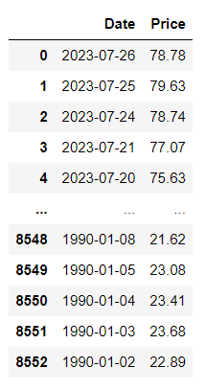
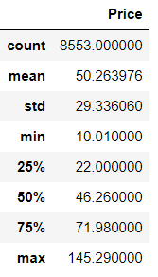
Data set details
Data set contains date column and price column.
Price in USD/BBL.
Dataset overview:
Date range: Jan1990 to July 2023
Number of data points: 8553
Columns: Date, Price
Price statistics:
Average price: $50.26 USD/BBL
Median price: $46.26 USD/BBL
Skewness: Right-skewed (higher prices are Less frequent)
Price variability:
Standard deviation: $29.33 USD/BBL
Minimum price: $10.01 USD/BBL
Maximum price: $145.29 USD/BBL

Slide 6
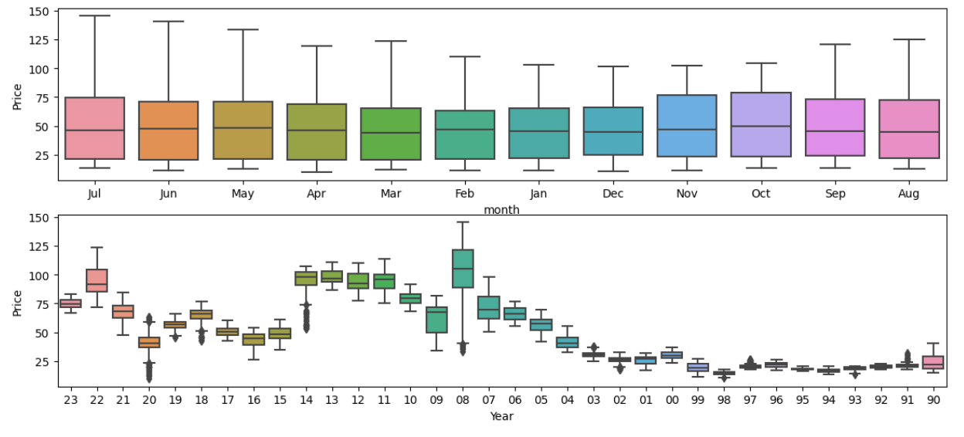
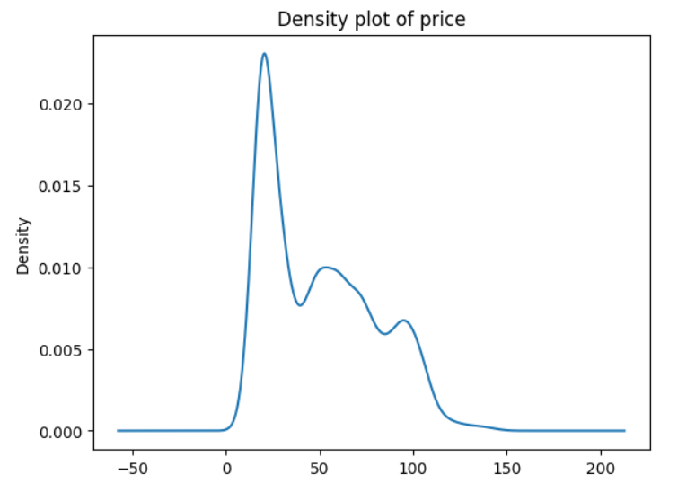
Distribution of price data
Data is right skewed
Outliers are present in yearly interval not in monthly interval

Slide 7
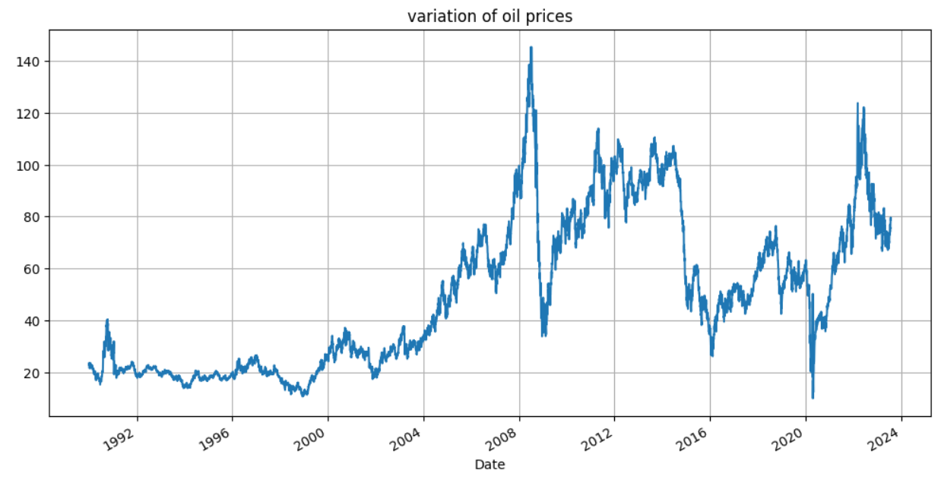
Visualizations
Oil price trend:
Since the early 2004s, the price of oil has generally been going up.
It reached its highest point in 2009 but dropped significantly during the global recession.
After 2009, the price started to rise again, especially from 2011 onwards.
However, in 2015, there was a notable decrease in oil prices due to increased oil production and other factors.
The COVID-19 pandemic in 2019-2020 had a significant impact on oil prices, with a sharp decline caused by lockdown measures and reduced economic activity.
As economies gradually reopened and recovered, the price of oil began to rise again.

Slide 8
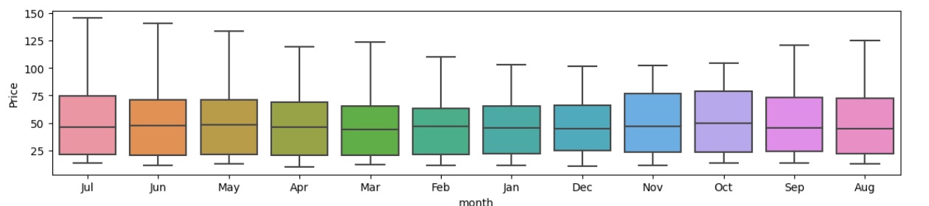
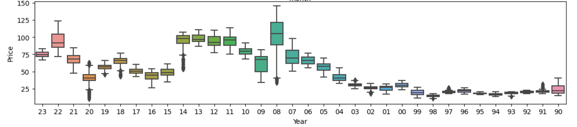
Month and Year wise Price in boxplot
When consider month wise of total data Total Jul data shows more range and Dec shows less range.
Median is almost same but upper range is highly varies.
When consider year wise total data ,it shows some outliers.
For removing outliers we do IQR capping method.

Slide 9

ADF Test
It internally does Hypothesis test
We will take Ho(Null Hypothesis) as Not stationary.
If p value higher than alpha value we will fail to reject Null hypothesis
And p < alpha then accept Alternate Hypothesis

Slide 10
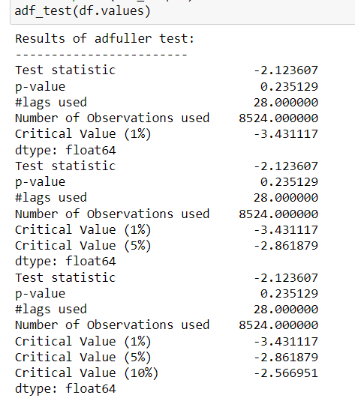
Stationary checking using ADF Test
But after ADF test its showing with data not stationary condition since p value 0.235129.
So failed to reject Null Hypothesis here since p> alpha(0.05 by default)
So time series is not stationary.

Slide 11
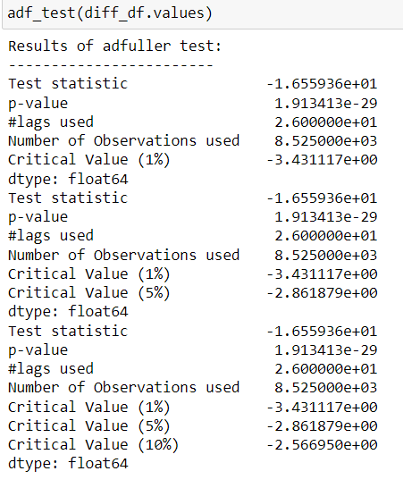
Stationary checking after Differencing
Time series is stationary because p value is less than level of significance(0.05).

Slide 12
Model Building

Slide 13
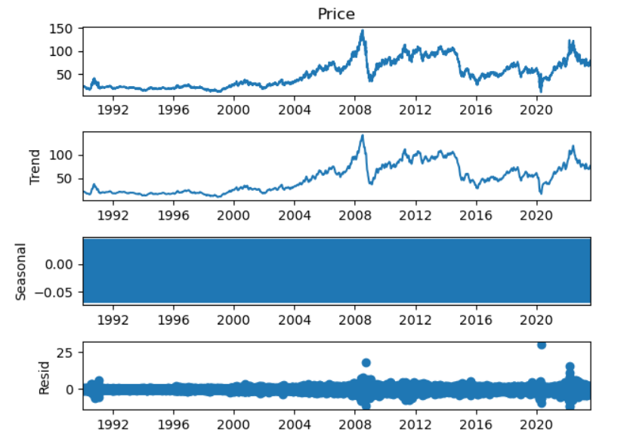
Time series Decomposition
Time series decomposition shows Trend Seasonality and residual.
It have trend but its not constant.
It have not seasonality

Slide 14
Model building and Model Validation
Created model
Found RMSE
Compared RMSE of other model and compared the plot
Plot which shows more close with test data and less RMSE should be selected as final Model

Slide 15
Data Driven models
ARIMA
SARIMA
PROPHET
LSTM
These models are used to pick the best smoothing value for smoothing techniques we performed hyperparameter tunning and after selecting the best value. We performed all data driven models and checked their RMSE values.

Slide 16
ARIMA Models Parameters and residual check
We considered ACF , PACF plot and plot crossing +-2SE line took as order parameters for MA and AR models and used LLR (Log Likely hood Test) for order confirmation by considering model performance in each order.

Slide 17
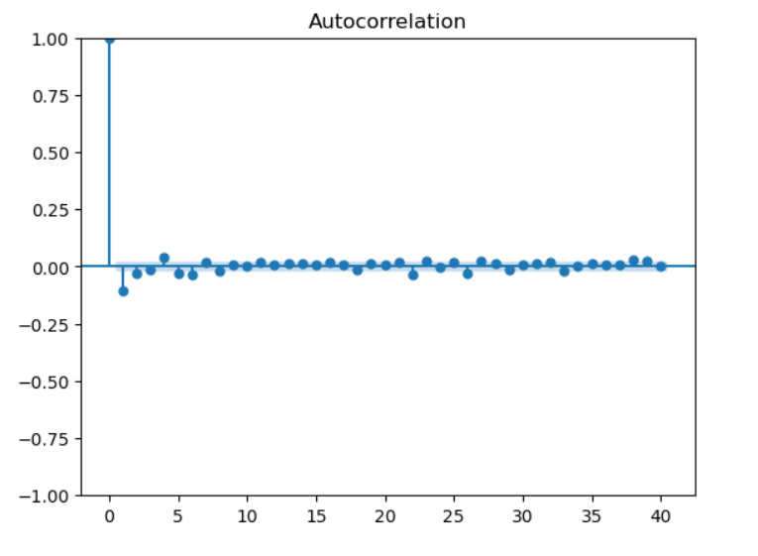
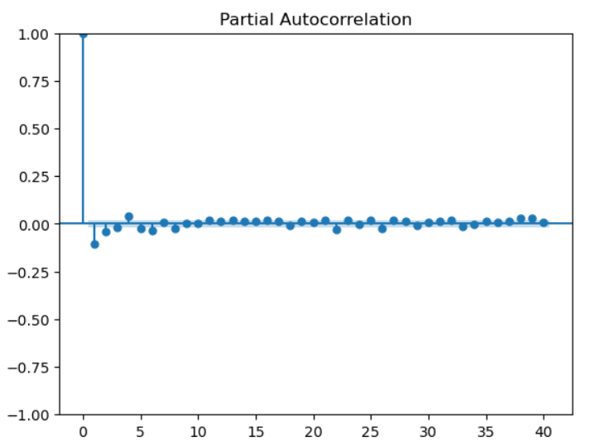
Model testing

Slide 18
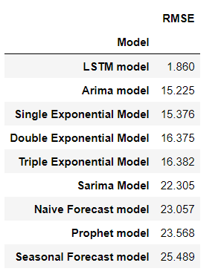
Different Model RMSE
We need to compare the forecasting plot also for model finalisation

Slide 19
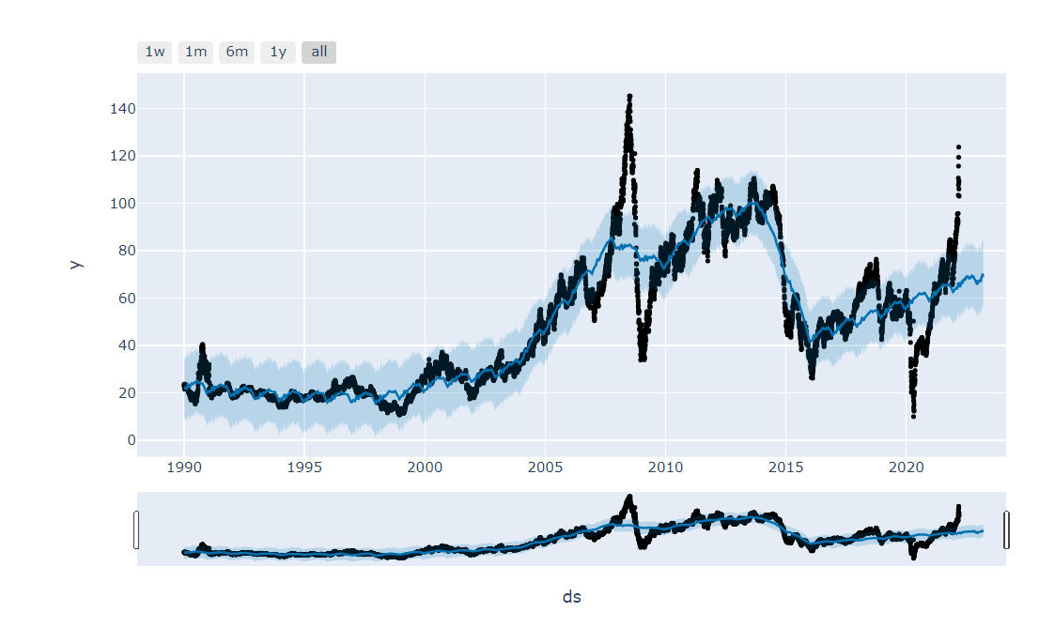
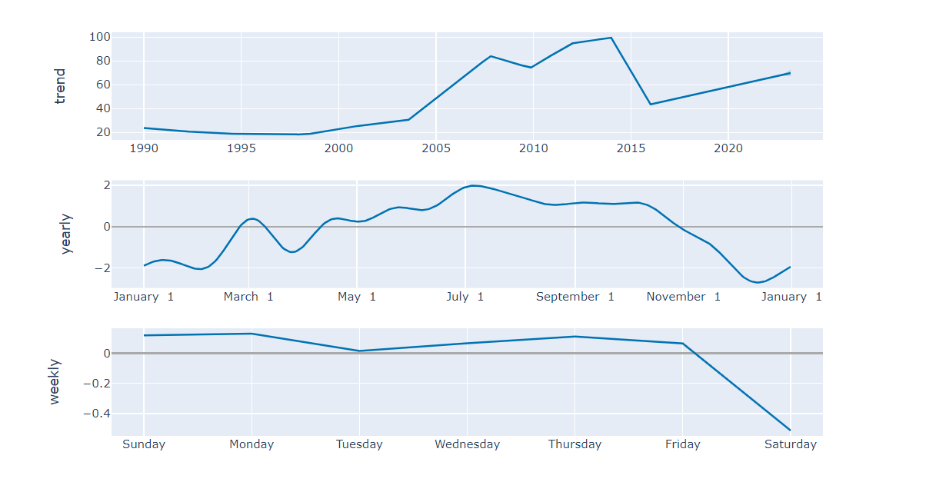
Plot of Forecasting
This is plot of prophet model.

Slide 20
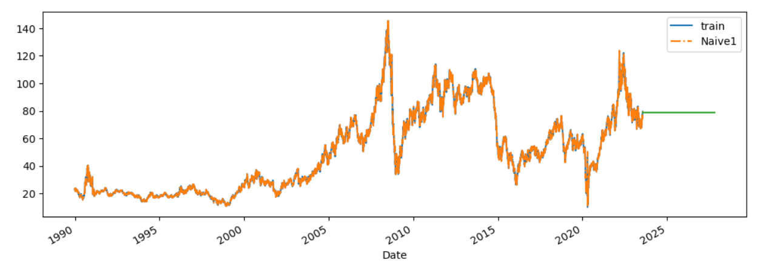
Plot of Forecasting
This is a plot of Naïve forecast.
Naïve method shows less RMSE than prophet model.

Slide 21
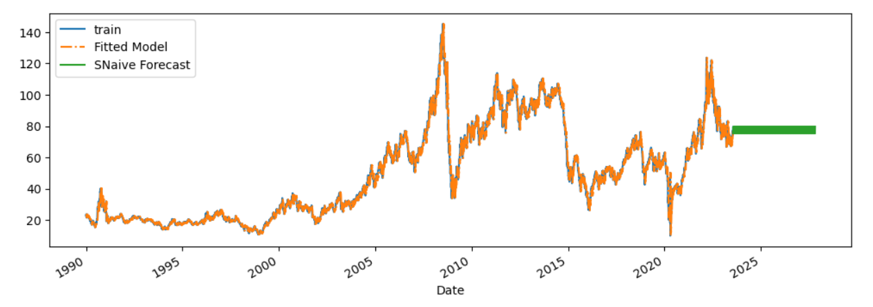
Plot of Forecasting
Seasonal Naïve Forecasting model have high RMSE value than other models.

Slide 22
Final Model
Since we see all the models, there is a LSTM model have less RMSE value. So we select the final model as a LSTM model. Thus it can be best suitable for prediction.

Slide 23
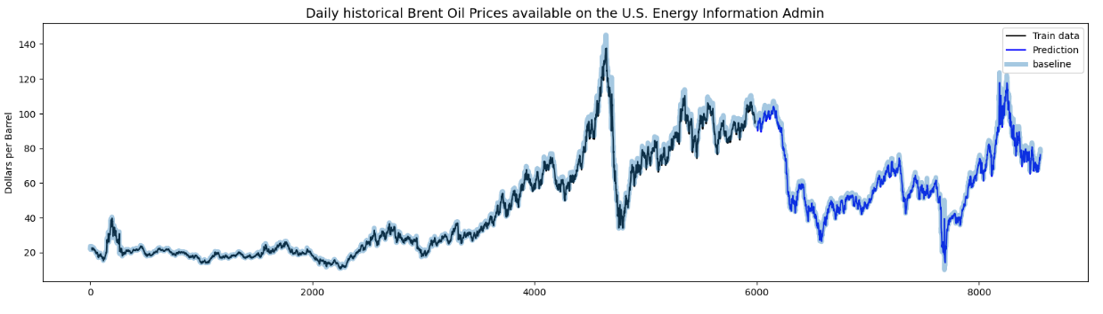
Plot of Prediction

Slide 24
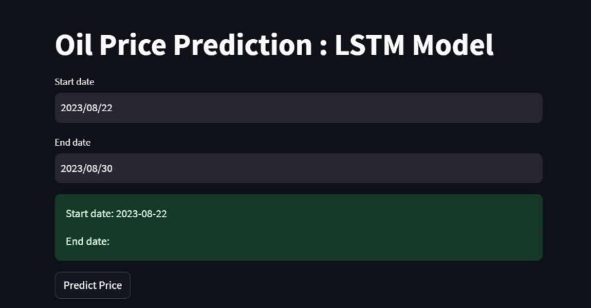
Model Deployment
Done Model Deployment using streamlit.

Slide 25
Problems Faced During Project
Sudden fluctuations in Price graph causes variation in prediction(Noise).
Data set is not Normal distributed so approached feature transformation.
Stability issues of dataset (To test it we have gone through different test ADF..)
Out Lier in dataset which could not omit since it was the part of time series.
It’s a time series and we had to convert the Date column to date time format
Data set: The data set is not contain day wise data so if day wise data also available model would have been performed well with more data.
Forecasting have lots of influencing factors which could not include in our model(Government policies, War , Natural calamities, Medical Emergencies, New Innovation in Technology, New innovations in fuel extraction…etc.)

Slide 26
THANK YOU

